Slide 1

prediction of disease in the poultry industry
JEEVA NILA.A 201CS185
AJAY GANDHI.V 201CS111
BRINDHA DHARSHINI.S 201CS133

Slide 2
Abstract
In the modern era of Information and Technology, gadgets and electronic devices are now inevitable in our day-to-day life.
Technology helps us to do our routine things in a wellorganized manner and move forward at ease. In this era, we do have a miniature computer (smartphone) carrying in our pockets, getting not only connected with others but also with the internet giving us a plethora of options and information at our fingertips. Modern technologies viz. Artificial Intelligence (AI),
. We use a few qualities to evaluate our analysis regarding poultry illness and this attribute is one of the key items of the following disease. Perhaps we implement eleven machine classifiers to measure analysis by employing the following technologies, Logistic Regression Classifier, Naive Bayes Classifier, Multilayer Classifier, Stochastic Gradient Classifier, r Random Forest classifier, Bagging Classifier, Decision Tree Classifier, K Nearest Neighbor Classifier, XGB Classifier, AdaBoost Classifier & Gradient Boosting Classifier
Keywords— Robots Sensors devices environmental impact Poultry Disease

Slide 3
PROBLEM IDENTIFIED
Future demands for food will place agricultural systems under pressure to increase production.
Poultry is accepted as a good source of protein and the poultry industry will be forced to intensify production in many countries, leading to greater numbers of farms that house birds at elevated densities.
But we find lot of issues faced by the poultry management and they have lots of doubt to clear the disease in order to rectify the problem early and save the chicks from disease

Slide 4
WHAT IS A DISEASE
An illness of the body in humans, animals or plants.
Any condition that result in deviation normal function
So poultry disease is the illness of the chick that affects the body in any way

Slide 5
Our idea is :
We need to create a dataset with the symptoms of the disease where the voice of the chick is normal or not
And we need to fix the voice recognition machine in every chick
If the voice of the chick is abnormal and the behaviour of the chick is differ from other healthy chick we conclude that the chick is affected

Slide 6
THE DATA SET CONTINES:
feather loss (unless birds are going through a natural moult)
general inactivity.
discharges.
abnormal droppings.
dull and/or closed eyes.
ruffled feathers.
drooped wings.
sitting on haunches or lying down

Slide 7
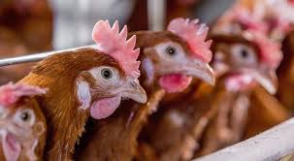
Some disease affected chicks
Some of the diseases spread by chickens. 1. Salmonella Salmonella is a germ that avian life usually carry. Poultry domesticated birds like turkeys and chickens — whether commercial farm chickens, backyard chickens, or organically-raised chickens — could all carry Salmonella.

Slide 8
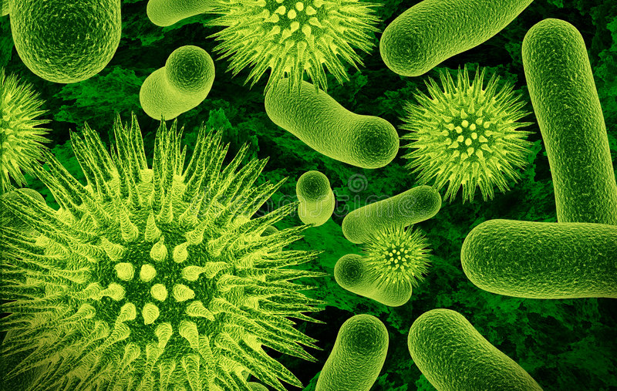
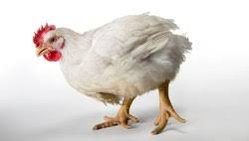
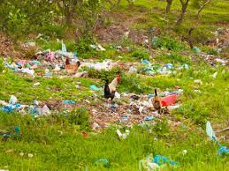
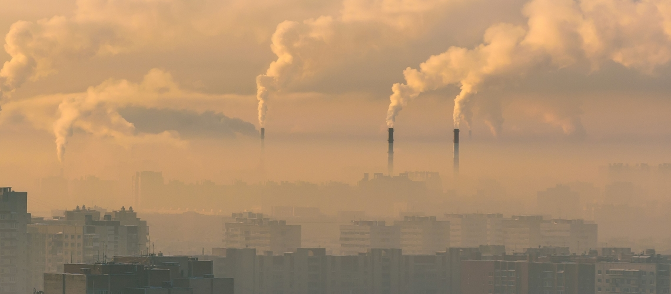
Some common factor for disease

Slide 9


